Slide 1
ENGLISH LESSON

Slide 3
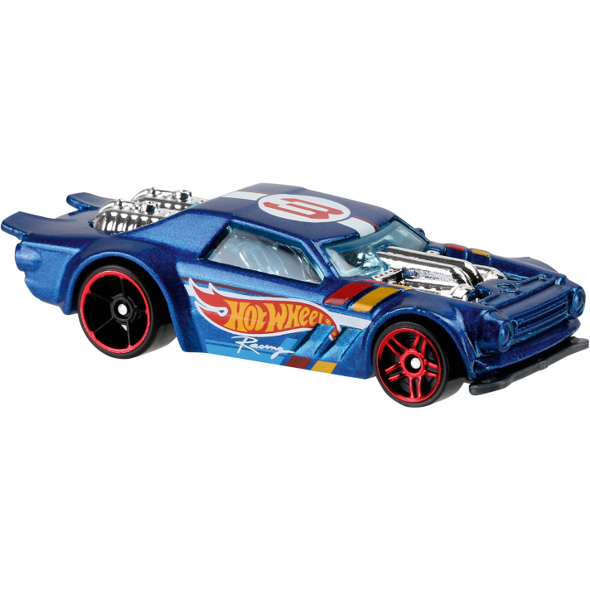
1. Whose are these sounds?
2. What does the racing car mean?
3. What wheels do racing cars have?

Slide 4
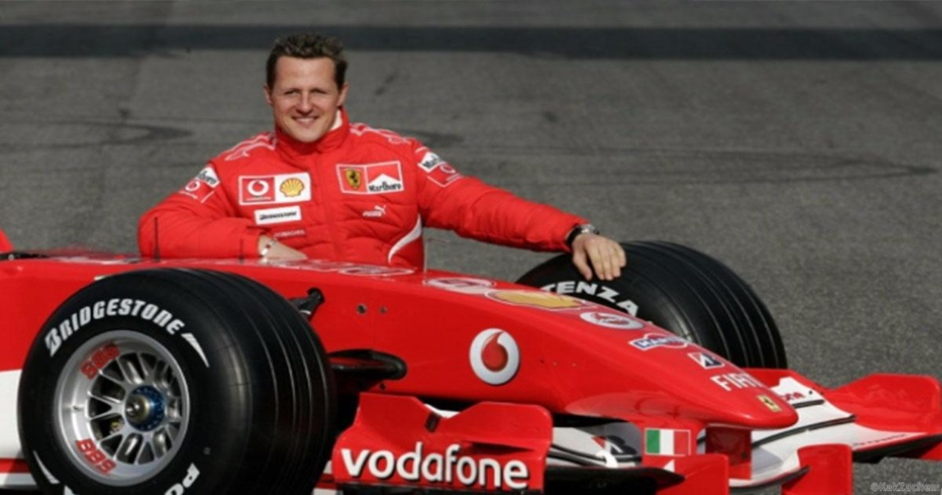
The aim of our lesson today is -
learning to describe the famous people

Slide 5
[ɔ:l] tall, fall, small, all
[h] whose, whole, who
[ɜː] her, deserve (заслуживать), reserve
[ju:] pupil, occupation
['ɔkju'peɪʃ(ə)n] (занятие),
population
[ʌ] son, come, London
[ɪ] fridge, Finland, Finnish

Slide 6
Schumacher‘s nickname is … .
He comes from … .
His hobbies are … and … .
He was born … .

Slide 7
Which paragraph includes:
personal details and hobbies?
what he is famous for?
the company he works for?

Slide 8
Full Name: Michael Schumacher
Occupation: ________________
Team: _________________
Born: ________________
Personal details:__________
_______________________

Slide 9
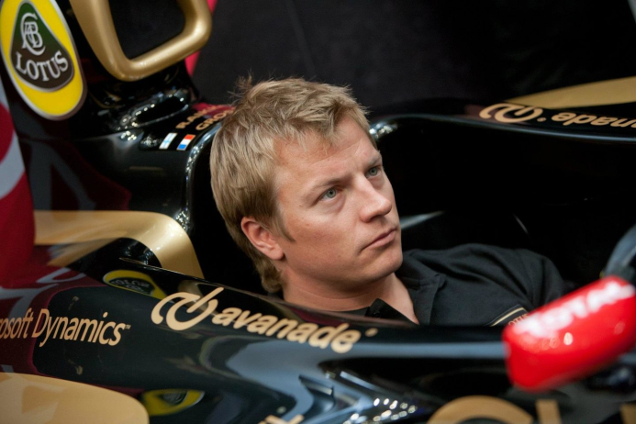
PLAN:
name, surname, nickname, occupation
born, nationality, facial features
hobbies

Slide 10
Thank you for your attention!!!

