Slide 1
MODULE 3a
(Spotlight 11) RESPONSIBILITY

Slide 2
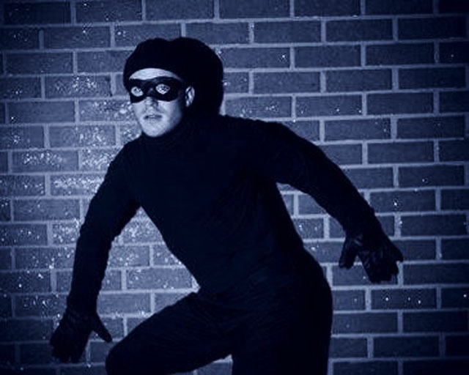
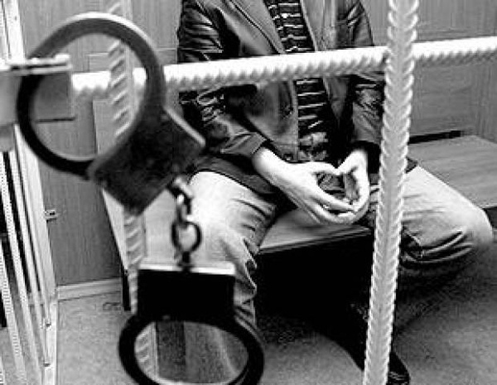
What issue are we going to discuss?
CRIME
RESPONSIBILITY
COURT
LAW
PRISON
PUNISHMENT

Slide 4
Which rights seem (the) most important to you.

Slide 5
There are different laws that protect human rights.
Do you know any of such laws? In our country.

Slide 6
What do you know about the Constitution of RF?
1.When was the first Constitution of Russia adopted ?
The first Constitution of Russia was adopted in 1918.
2. What about modern Constitution? When was it adopted?
It was adopted on the 12th of December 1993.
3. How many articles does it have?
It has 137 articles.
4. What rights does the Constitution protect?
The Constitution of Russian Federation protects the rights to life, work, housing, free thoughts and many other things.

Slide 7
Have you been the victim of a crime?
burglary [bɜ:ɡləri]– кража со взломом
burgle – красть со взломом
chase – преследовать
convict - выносить приговор, осуждать
culprit – преступник (виновный)
distract – отвлекать, уводить в сторону
fee – плата
fraudster [frɔ:dstə]– мошенник, аферист
grab – схватить, хватать
guilty [ɡilti]–виновный
gullible [ɡʌlibl] - доверчивый

Slide 8
NEW WORDS & PHRASES
identify [aidentifai]– опознавать, идентифицировать
means – средство, способ
mug – нападать, грабить
mugging – уличный грабеж
offence – нарушение, проступок
pickpocket – вор- карманник
petty [peti] – незначительный
scam – афера
shaken up – взволнованный, потрясенный
shoplift – воровать товары из магазина
threaten [Ѳretn]- угрожать
witness – свидетель

Slide 9
NEW WORDS & PHRASES
PHRASES
break the law – нарушать закон
catch smb. in the act – поймать на месте
catch smb red handed – поймать с поличным
confess to the crime – сознаваться в преступлении
fall for smth – попасться на удочку,обмануться
find smb. guilty – признать виновным
give evidence in court – дать показания в суде
investigate the crime - расследовать преступление
out of the blue – ни с того, ни с сего (неожиданно)
take sb for a ride – обманывать кого-л, подшутить
trick gullible people – обмануть доверчивых людей

Slide 10
Read the tittle of the headings below. What do you think the text is about?
Nasty atack – отвратительное нападение
Unlucky muggers – невезучие грабители
Fraud victim – жертва обмана
Caught in the act – пойман на месте преступления
Common trick – обычный обман

Slide 11
LISTEN, read and check
1 – FRAUD VICTIM.
2 – CAUGHT IN THE ACT.
3 – NASTY ATTACK
4 – COMMON TRICK

Slide 12
Which words/ phrases helped you to find answers?
These terrible fraudsters (мошенники) are just trying to trick (обмануть) gullible (наивных) people.
The police caught them red-handed ( с поличным).
The attacker (нападающий) just came out of nowhere.
This has been happening a lot lately.

Slide 13
Ex. 4a p. 46
Use words from the text to complete the table.

Slide 14
Crime
Criminal
Verb
bank robbery
bank robber
rob (a bank)
burglary
burglar
burgle
mugging
mugger
mug sb.
shoplifting
shoplifter
shoplift
theft
thief
steal (a car)
fraud
fraudster
trick people
pickpocketing
pickpocket
steal (sb’s purse)
murder
murderer
murder

Slide 15
Which of the crimes is most serious? Why do you think so?
Go to court
Pay a fine
Go to prison
Get off with warning
Do community service

Slide 16
Who helps people to investigate the crime?
police officer
lawyer
investigator – следователь
specialist in crime detection – криминалист
walking officer - сотрудник патрульной полиции
detective officer - сотрудник уголовной полиции
district police officer – участковый

Slide 17
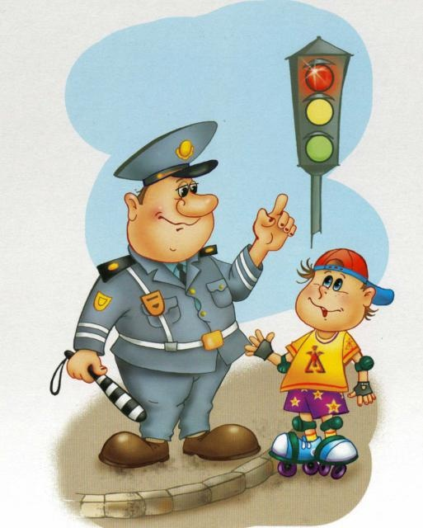
DESCRIBE PICTURES

Slide 18
A robber is someone
who tries to trick gullible people
A burglar is someone
who takes things which do not belong to them
A mugger is someone
who takes a person by force and demands a ransom
A shoplifter is someone
who attacks people in the street in order to steal something
A thief is someone
who breaks into people’s houses to steal things
A vandal is someone
who kills somebody on purpose
A pickpocket is someone
who damages property on purpose
A kidnapper is someone
who uses any means to steal things (purses, mobiles etc.) from pockets or bags
A fraudster is someone
who steals something from shops, banks, etc
A murderer is someone
who steals something from shops

Slide 19
Choose the correct words. Check in the world list.
Adam has got to go to court for a driving offence / crime.
The burglars were arrested and taken/ driven to court?
It’s unlawful/illegal to trespass on private property.

Slide 20
Choose the correct words. Check in the world list.
4. The judge announced / found him guilty of murder.
5. The murderer received a life sentence / imprisonment.
6. There were no witnesses / suspects to the accident.

